Slide 1
DevOps Kevin Remde Sr. Technical Evangelist Microsoft Corporation

Slide 2






Value delivery challenges
40
%
… of implementations end up getting reworked because they don’t meet the users’ original requirements
IT drives business
success!
High IT performance correlates with strong business performance, helps boost productivity, market share and profit
Outperforming teams are
collaborate
54
%
extensively
more likely to
41
%
… of development budgets for software, IT staff and external professional services will be consumed by poor requirements
with their
Collaboration blockers
counterparts
80
%
failure rate …
26.7% No executive support
56.7% Cultural inhibitors
43.3% Fragmented processes
… for companies that try to adapt their existing tools for DevOps practices
Developers
IT Ops
%
Business
70
o
f
CIOs
Would increase risk
1 in
6
It takes on average 200 minutes to diagnose and repair a production issue
IT decision makers is still unfamiliar with the term DevOps
to reduce IT costs
and accelerate business agility
3/4
of teams
DevOps was being initiated by more development teams than IT Ops teams by about a 40% to 33% margin
The average hourly cost of infrastructure failure is $100,000 per hour
A bug caught in production ends up costing
than if the same bug was found earlier in the development cycle
Responding to ongoing needs for efficiency and growth
100x more
have adopted
Agile methodologies
dual goals
Always keeping all systems safe and secure

Slide 3

What is DevOps?
“It’s a job title”
“It’s automation”
“It’s Development and Operations collaboration”
“It means faster and smaller releases”

Slide 4
The converged DevOps lifecycle
Plan + track
Release
Development
Production
Develop + test
Monitor + learn

Slide 5



The DevOps conversation
Collaborate more
Share common goals
Focus on improvement
BRINGING PEOPLE TOGETHER
PEOPLE
Eliminate waste
Increase efficiency
Streamline feedback
DELIVERING VALUE FASTER
PROCESS
Enhance productivity
Enable collaboration
Facilitate experimentation
EXECUTING A DEVOPS STRATEGY
TOOLS

Slide 6
DevOps habits and practices
PRACTICES
Application Performance Management
Infrastructure as Code
Continuous Deployment
Release Management
Configuration Management
Automated Recovery
PRACTICES
Automated Testing
Continuous Integration
Continuous Deployment
Release Management
PRACTICES
Usage
Telemetry Monitoring
Collection Testing in Production
Stakeholder Feedback
PRACTICES
Code Reviews
Automated Testing
Continuous Measurement
FLOW OF CUSTOMER
VALUE
TEAM AUTONOMY & ENTERPRISE ALIGNMENT
BACKLOG
refined with
LEARNING
EVIDENCE gathered in PRODUCTION
MANAGED
TECHNICAL DEBT
PRODUCTION FIRST MINDSET
INFRASTRUCTURE is a FLEXIBLE RESOURCE
PRACTICES
Testing in Production
Usage Monitoring
User Telemetry
Stakeholder feedback
Feature flags
PRACTICES
Application Performance Management
Infrastructure as Code
Continuous Delivery
Release Management
Configuration Management
Automated Recovery
PRACTICES
Enterprise Agile
Continuous Integration
Continuous Deployment
Release Management

Slide 7




Visual Studio Team Services
Open, flexible and extensible cross-platform DevOps tools
Unlocks a greater ecosystem and works with what you already use
Team Foundation Server
More agility and flexibility for continuous value delivery

Slide 8

The Microsoft DevOps solution
Overview

Slide 9

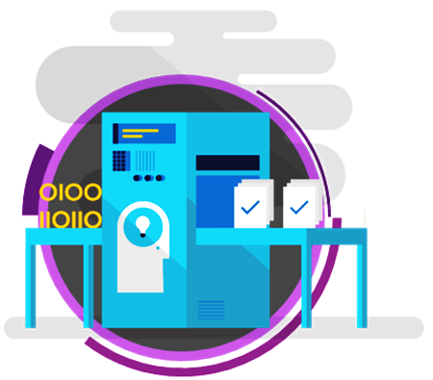

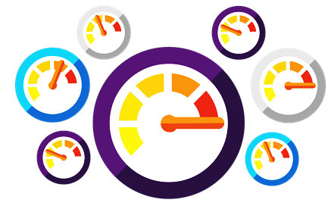
The Microsoft DevOps solution
An integrated, end-to-end solution for teams of any size to design, build and manage enterprise solutions and cross-platform mobile business apps.
Shorten cycle times and deliver value faster
Improve quality and availability
Optimize resources and eliminate waste
Deliver mobile apps with digital-era velocity

Slide 10




End-to-end DevOps
1
4
Plan + track
Monitor + learn
Development
Production
2
3
Develop + test
Release

Slide 11

Plan + track
It starts with an idea - and a plan how to turn this idea into reality…
Project starts
Manage work
Develop + test
1
Track progress
Plan

Slide 12
Plan + track
Visual Studio Team Services and Team Foundation Server give you the tools you need to effectively create, manage and deliver against your backlog.
Enterprise collaboration
Agile planning tools
Dashboards & charts

Slide 13

Develop + test
After the iteration starts, developers turn great ideas into features and functionality …
2
Write code
Unit testing
Version control
Build
Build verification
Release

Slide 14
Source code management
VSTS and TFS provide unparalleled flexibility for your evolving codebase. All your code is linked directly to the story, bug, or task driving the work.
Flexible version control
Collaborate on code
Any IDE, any code

Slide 15
Test management
A toolset optimized for QA professionals, giving them flexibility in how they work while at the same time keeping them in sync with the rest of the team.
Test planning and tracking
Developer testing
Manual and exploratory testing

Slide 16
Cross-platform build
No matter what tools you use or what language you prefer - Team Foundation Build builds your app your way, for your platforms. Just open your browser!
Cross-platform build for iOS, Java and Android
Flexible, extensible and customizable builds
Cloud, hybrid or on-premises infrastructure

Slide 17



Continuous integration (CI) – a DevOps practice
SOURCE
REPOSITORY
BUILD
Issues
Delivery delays
Non-working/low-quality code
Incomplete solutions
Rework
Value
Frequent integration
Higher quality
Repeatability
TEST
DEV
OPS

Slide 18


Release
When all tests pass, the build is deployed to testing environments for each stage in the release process …
Cloud load testing
Integration testing
environment
Staging
environment
3
Monitor + learn
Automated functional testing environment
Pre-production environment

Slide 19
Infrastructure as code (IAC) – a DevOps practice
SOURCE
REPOSITORY
DEV
Value
Optimize resources
Accelerate delivery
STAGE
Measure
Deployment rate
MTTR
PRODUCTION
DEV
OPS

Slide 20
Continuous delivery (CD) – a DevOps practice
SOURCE
REPOSITORY
DEVELOPMENT
Issues
Slow delivery cadence
Limited predictability when deploying
Complexity when deploying
Value
Consistency
Accelerated deployment
Repeatability
Human error reduction
STAGING
PRODUCTION
DEV
OPS

Slide 21
Continuous delivery
Streamline and automate the workflow between development and IT ops and deliver higher quality software more frequently with less risk.
Continuous integration
Release management
Continuous quality

Slide 22

Monitor + learn
When all tests pass, the build is deployed to testing environments for each stage in the release process
Plan the next iteration
Feedback
Monitor
4

Slide 23
Monitor + learn
Streamline and automate the workflow between development and IT ops and deliver higher quality software more frequently with less risk.
Stakeholder feedback management
Application telemetry
Performance and load testing

Slide 24

The Microsoft DevOps Solution
DevOps for the digital era

Slide 25

Mobile app CI and CD
Code repository
Build + deploy
Automated testing
User testing
Backlog
Monitor and improve

Slide 26
Our solution for mobile DevOps
Tools for continuous integration, beta deployment, crash analytics and monitoring of mobile applications that are distributed through app stores.
Automate and orchestrate build, test and release
Friction-free mobile app deployment and beta testing
Close the loop between Development and Operations

Slide 27
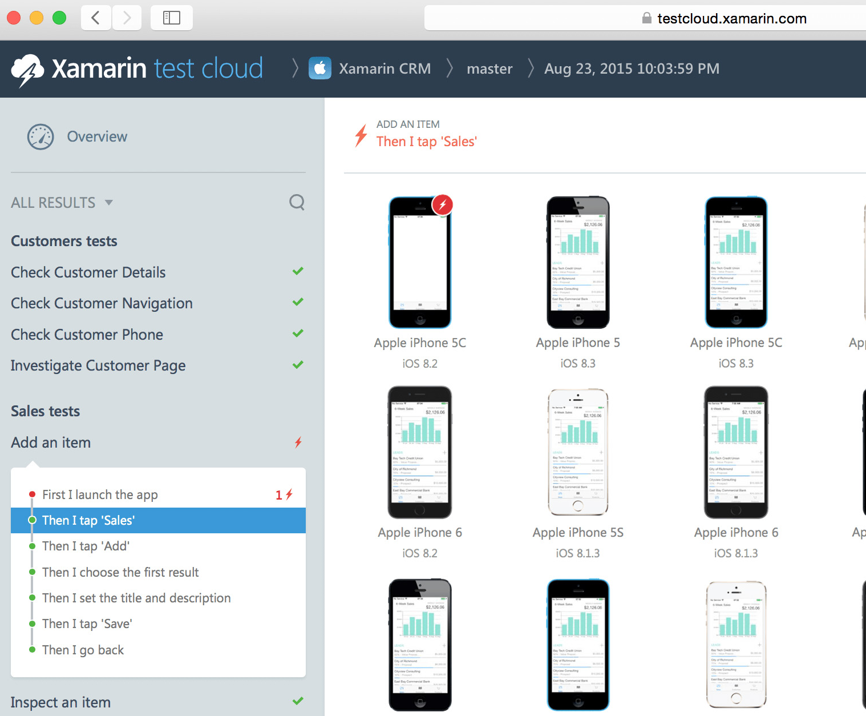
Xamarin test cloud
2,000+ devices
Automate your app testing and run them on over 2,000 different real devices. Test everything users do, as well as any performance problems with step-by-step memory and performance tracking.
Real devices, real quality
Ensure higher quality by testing on real devices
Automate app testing on over 2,000 real devices
Use C#, Ruby, or Cucumber to build automated tests
Integrates with any continuous integration system

Slide 28
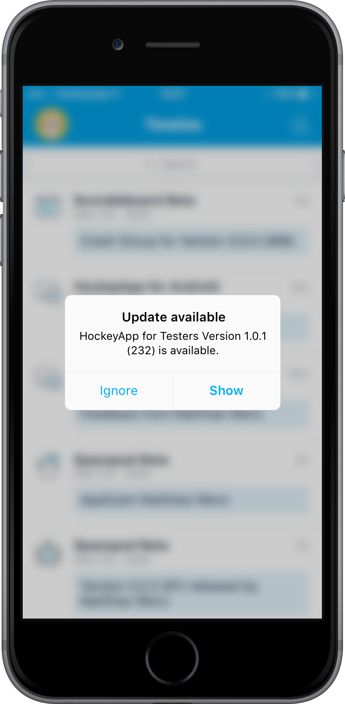
HockeyApp beta distribution
In-house App Store for testers
Upload beta versions of your application to the HockeyApp store to allow testers to install and test beta versions on actual devices.
Deployment made easy
HockeyApp’s desktop application automatically tracks all necessary information about your latest build in order to make uploading beta versions easy.

Slide 29
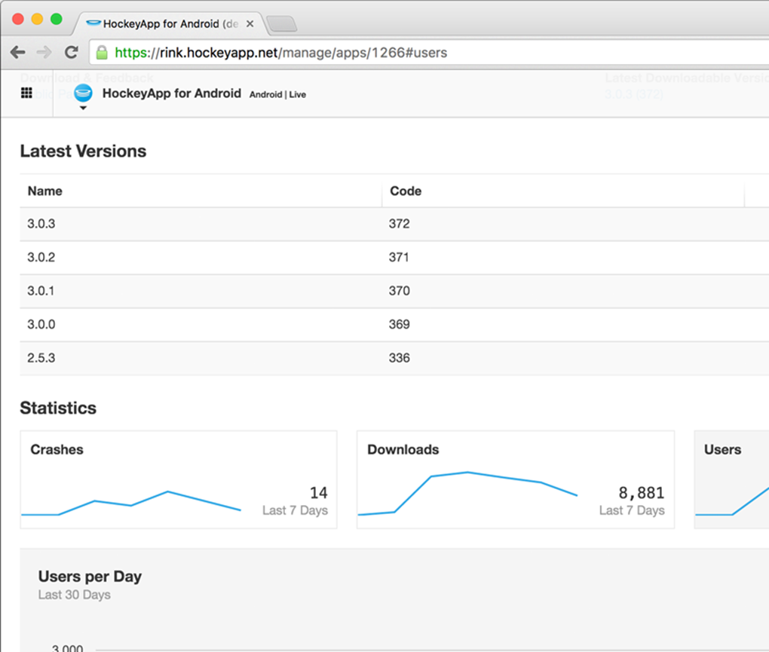
Beta test coverage
Real usage matters
Advanced metrics to see which devices were used, how long the app was used for, and which language was tested. No additional setup.
Detailed charts
HockeyApp features both raw data from analytics as well as live, interactive charts for the most important metrics.

Slide 30
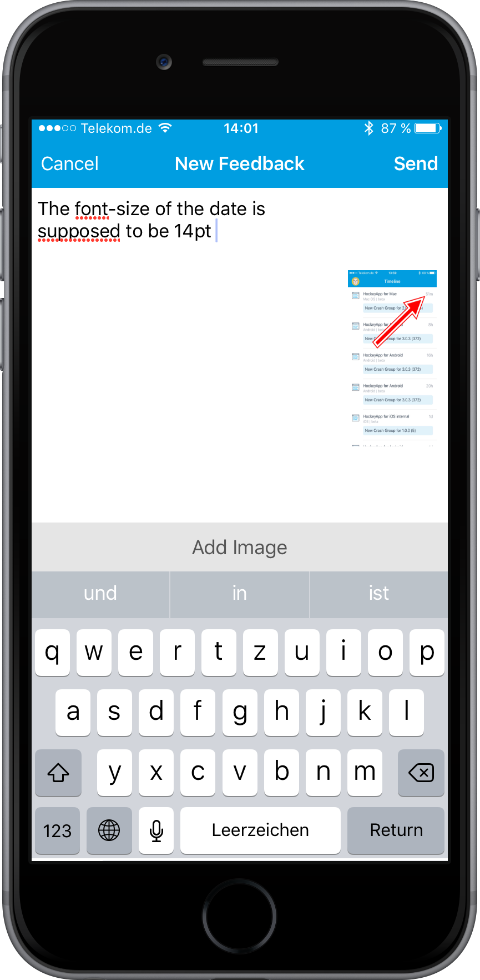
User feedback management
A conversation with your users
All feedback is handled as discussions. You can manage discussions in the web interface or through email. Search discussions, mark them as completed or create work items based on them. Give your users a voice outside of the app store.
For all development phases
You can use the feedback feature for all builds of your app or just beta versions. Either way, HockeyApp makes it easy for users to tell you what's what. Let them post ideas right from within your app.

Slide 31
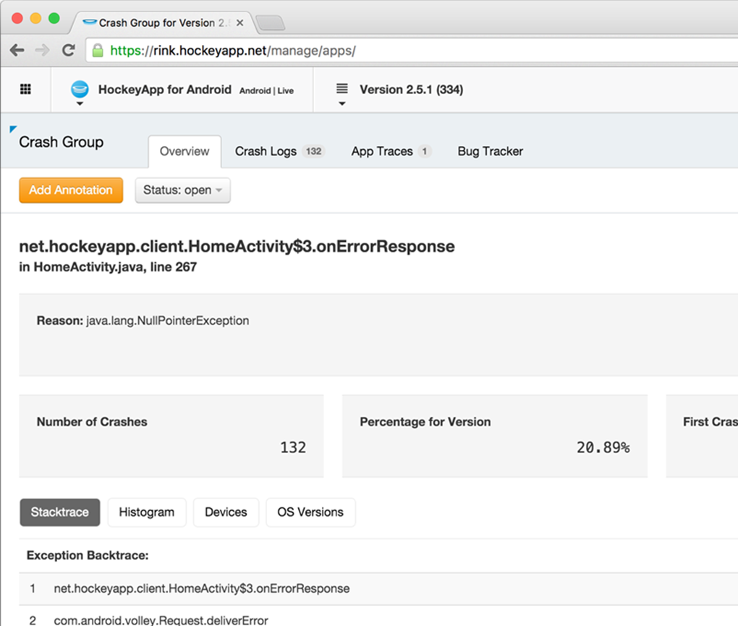
HockeyApp crash analytics
No additional code
By integrating HockeyApp’s open source SDK for Android, iOS, Mac, and Windows your apps can send crash reports directly to HockeyApp, no additional code needed.
Powerful crash analytics
HockeyApp processes and symbolicates all crash reports. This gives you meaningful stack traces with friendly class names, methods, and accurate line numbers.

Slide 32
The Microsoft DevOps solution
Open and extensible

Slide 33
Extend, customize, and integrate
Customize and extend the Microsoft DevOps platform and create the perfect development environment that you'll love as much as your code.
Open platform
Extensions
Visual Studio Marketplace

Slide 34

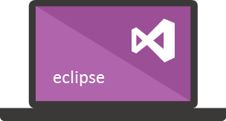





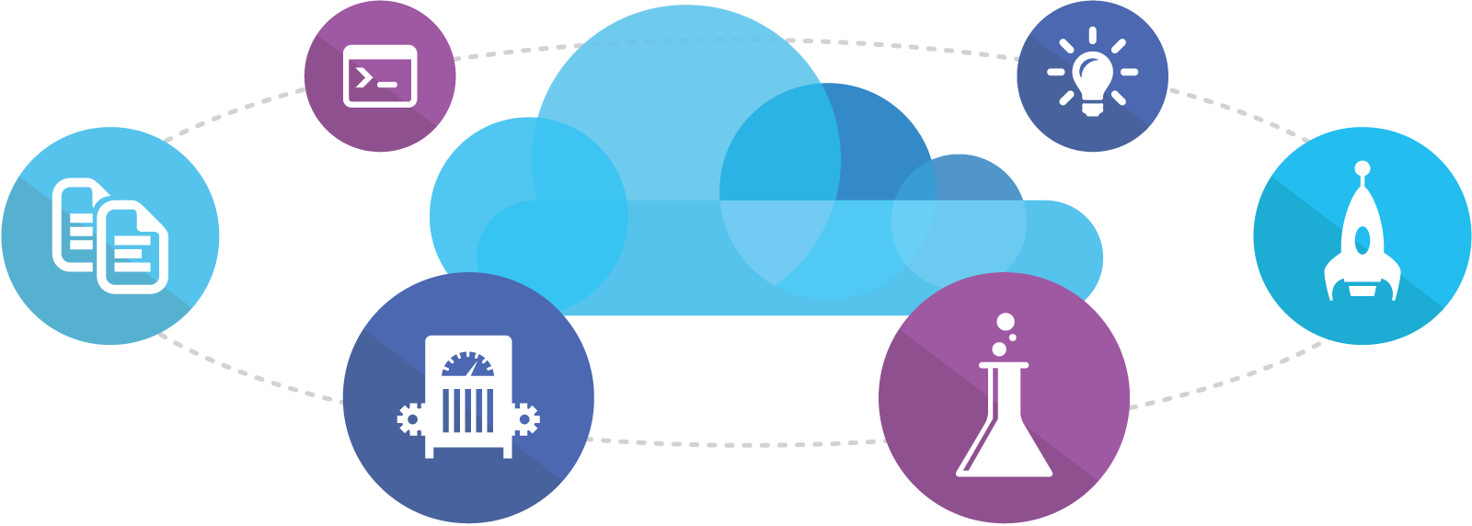
Microsoft Tooling
People | Process | Tools
Developer IDE
Build/CI
Release/CD
Develop
Build + Test
Monitor
Deploy
Team Collaboration
Release Management for Visual Studio
Test
Monitor + Learn
Automation Service
PowerShell | WAML
Azure Resource Management
Application Insights
Microsoft Test Manager
xPlat Command Line
On-Premises | Hybrid | Cloud

Slide 35












OSS Tooling
People | Process | Tools
Developer IDE
Build/CI
Configuration
Develop
Build + Test
Monitor
Deploy
Team Collaboration
Release
Monitor + Learn
Test
On-Premises | Hybrid | Cloud

Slide 36

DevOps benefits
Strong IT performance is a competitive advantage
Deploy code 30x faster
… and with 200x shorter lead time when compared to lower-performing peers
Firms with high-performing IT organizations were 2x as likely to exceed their profitability, market share, and productivity goals
DevOps practices
improve IT performance
Have 60x fewer failures
… and recover from failure 168X faster when compared to lower-performing peers

Slide 37
The shift to DevOps
OLD WORLD
Focus on planning
Compete, not collaborate
Static hierarchies
Individual productivity
Efficiency of process
Assumptions, not data
NEW WORLD
Focus on delivering
Collaborate to win
Fluent and flexible teams
Collective value creation
Effectiveness of outcomes
Experiment, learn, and respond

Slide 38
Hands-on-Lab
http://bit.ly/gabc17msp-hols
“HOL 7.1 - Simple CD in Azure”
Set up a VSTS account
Automate the App Service Creation, Provision the Environment (git clone and git add ., etc.)
Configure Simple Continuous Deployment
Notes:
Set-ExecutionPolicy -ExecutionPolicy Unrestricted -Force -Scope Process
Connect (link) Azure to the VSTS Project

Slide 40
Appendix instructions
Use the appendix slides to build a customized narrative by adding specific solution/feature/SKU/ISV details to your deck.
Choose the features that are most interesting for your customer and a) demo live or b) insert feature slides
Use the DevOps Lifecycle slides as a frame for an end-to-end story or feature demo
How to use
How to use
How to use
How to use the appendix slides

Slide 41
DevOps solution details

Slide 42
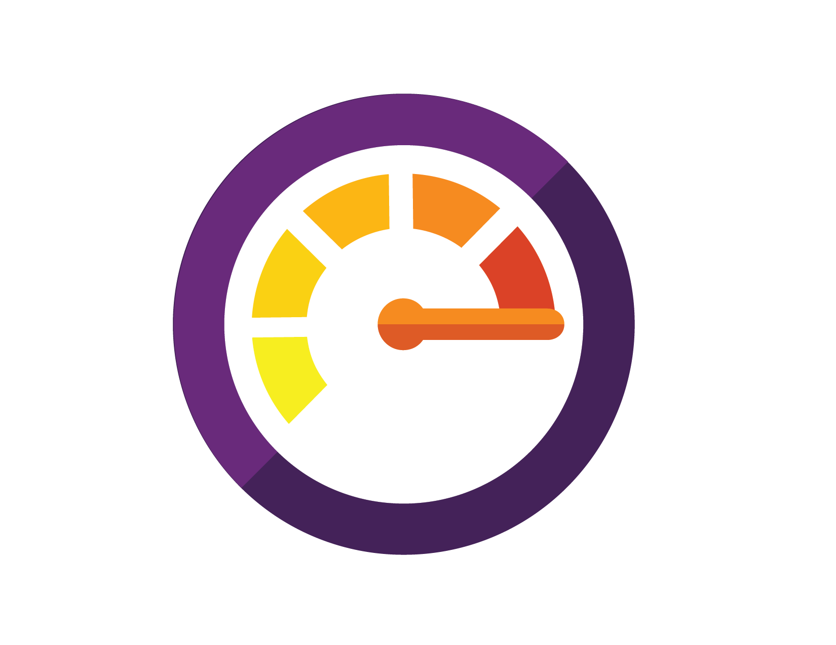


Agility and DevOps
Deliver winning applications using a comprehensive set of best-in-class tools and technologies that align development and operations teams, working on-premises, in the cloud, or in hybrid environments.
What is it?
The Microsoft DevOps solution enables organizations to shorten cycle times while improving software quality by streamlining the entire development workflow, from the backlog, through build and test, all the way into production, with real-time monitoring for availability and performance as well as user analytics to help inform the business on what to focus on next. With support for on-premises, in the cloud, or hybrid infrastructure, the Microsoft DevOps solution is the only comprehensive set of best-in-class tools and technologies that help you increase agility, improve quality, and save time and money in the process.
Microsoft helps you and your business:
Shorten cycle times
Improve quality & availability
Optimize resources
End-to-end capabilities
The Microsoft DevOps solution provides a comprehensive set of best-in-class tools and technologies that help you deliver the right applications, right now.
1
Best-in-class development tools
2
Sandbox cloud environments
3
Release management tools
4
Monitoring tools for the learning organization
Build applications with Visual Studio that are instrumented and operations-ready from day one.
Continuously test your applications, including performance, and automate test cases with every iteration.
Plan and track work for the entire team with portfolio backlogs and task boards.
Provision environments on demand in Microsoft Azure to progressively develop and frequently test every release so that you can deliver with confidence.
Create virtual machines and other containers, configure networking, and deploy dependencies, straight from Visual Studio or with the Azure self-service web UI.
Continuously integrate and promote features to production by instantiating a delivery pipeline governed by Release Management for Visual Studio.
Plan and automate deployments to complex environments using the Release Management console, making your workflow traceable and repeatable.
Institute a data-driven culture by gathering and analyzing real-time telemetry from applications in production using Visual Studio Application Insights.
Constantly capture performance and availability data to quickly detect and resolve quality issues.

Slide 43
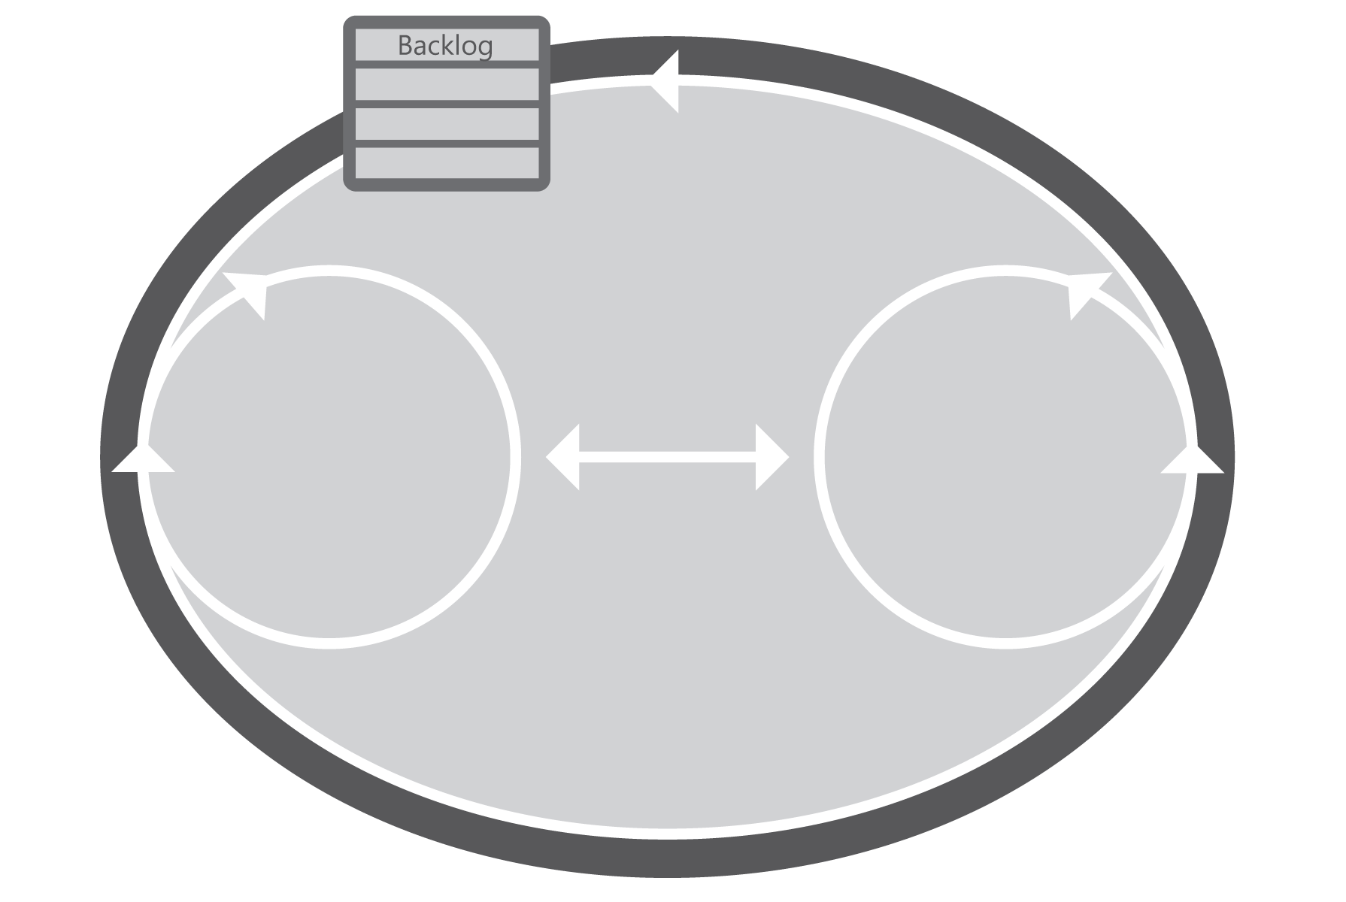

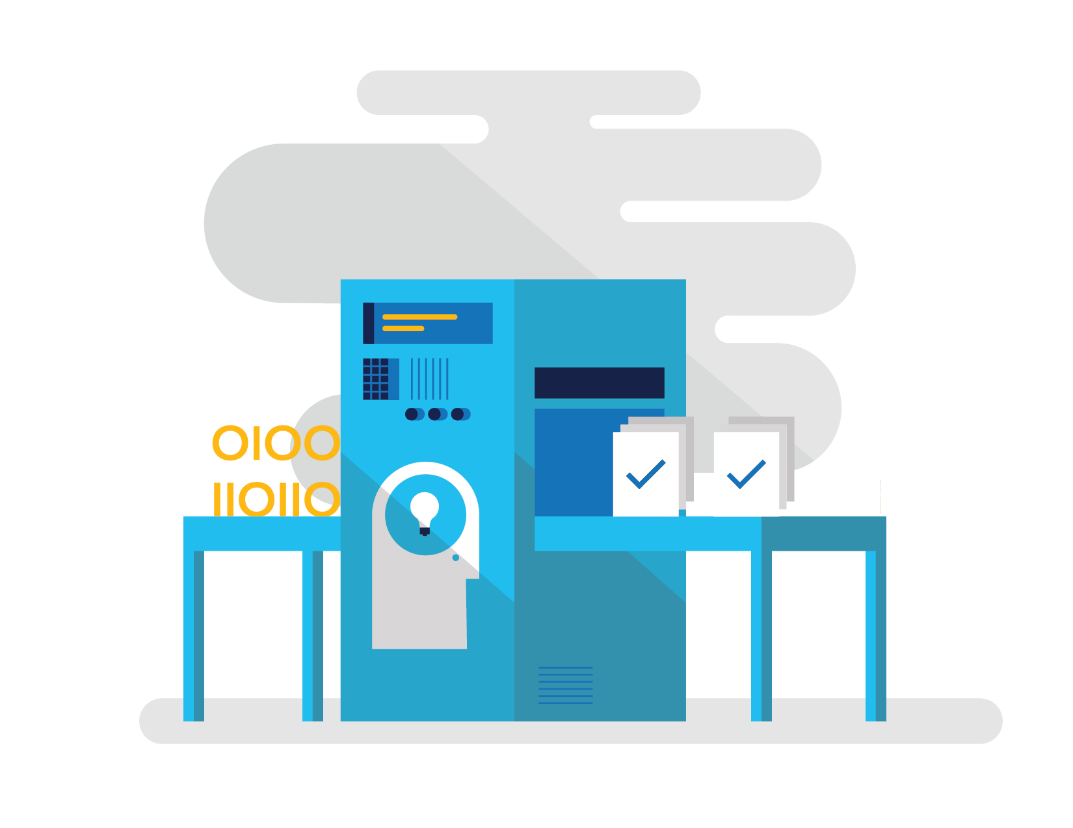
Solution delivered by Microsoft
Visual Studio, Team Foundation Server, Visual Studio Online, System Center, and Microsoft Azure are the key components of the Microsoft DevOps solution.
End-to-end agility starts where you are
Stay competitive by cultivating a culture of data-driven decision making, continuously learning what is valuable by delivering and measuring it. Equip your teams with tools and technologies that integrate with your existing heterogeneous infrastructure investments and empower them to achieve your goals efficiently and cost effectively.
Shorten cycle times and increase the traceability of each release by empowering development and operations teams with collaboration and automation tools.
Plan
Monitor + Learn
Improve quality and availability by using tools to capture rich telemetry on application performance and usage so that you can make better decisions on future investments—all while understanding and anticipating issues in production before they impact your service.
Development
Collaboration
Production
Optimize resources by efficiently managing environments with technologies that support self-service provisioning in a secure way and in compliance with your standards on IT governance.
Develop + Test
Release
The most convenient way to acquire what you need
MSDN subscriptions are the backbone of your team’s productivity and the best way to buy Visual Studio, Team Foundation Server, and Visual Studio Online. Available through role-based products for developers, testers, and system administrators, they provide all the software, online services, support, and training you'll need. MSDN subscriptions also include up to $150 of monthly Azure credits.

Slide 44
ISV solutions slide

Slide 45


Top ISV solutions in Dev Ops/Dev Test solutions
Premium Managed Linux
Containerize applications with CoreOS. By providing a self-updating OS, distributed systems tools and automated build tools, CoreOS helps companies focus more time on development and less time on operations. CoreOS is designed with security, consistency and reliability in mind and uses Docker and Rocket containers to manage applications. Key Use Cases/ Benefits Utilizes 40% less RAM than typical Linux server installations CoreOS machines are patched and updated frequently with system patches and new features CoreOS is designed for very large scale deployments. PXE boot and diskless configurations are fully supported.
Availability: Global Average Deal Revenue: $8.6K/mo Link to AppCatalog Link to Marketplace
Docker
Organizations want to innovate faster to maintain their competitive edge. Evolving to distributed applications enable rapid updates of many small application services but bring new challenges of managing a complex dependency matrix with diverse language stacks, configuration dependencies and tooling. Key Use Cases/ Benefits Ship more features faster and easier Gain seamless portability of apps across environments Dynamically update, change and scale applications Setup development environments much faster
Availability: Global Average Deal Revenue: $2.7K/mo Link to AppCatalog Link to Marketplace

Slide 46
Visual Studio features slides

Slide 47
Visual Studio… now with Xamarin
Visual Studio Community
Tools for non-Enterprise scenarios
Key scenarios
Hobbyists, students, OSS, small teams
Create applications for Android, iOS, and Windows
Runs on Windows
Share code across devices
Debugging code
Key IDE features
Build (incl. remote Mac agent)
Native designers
Debugger
Xamarin.Forms
New Dev Essentials benefits
Access to recorded Xamarin University classes
Xamarin Studio Community
Tools for non-Enterprise scenarios
Key scenarios
Hobbyists, students, OSS, small teams
Create applications for Android and iOS
Runs on OS X
Share code across devices
Debugging code
Key IDE features
Build (incl. remote Mac agent)
Native designers
Debugger
Xamarin.Forms
New Dev Essentials benefits
Access to recorded Xamarin University classes
Visual Studio Professional
Tools for individual developer and small team productivity
Key scenarios
Unrestricted, professional mobile development, code sharing, and debugging
Key IDE features
No usage restrictions for Visual Studio
No usage restrictions for Xamarin Studio
New subscription benefit
Access to advanced content on Xamarin University
Visual Studio Enterprise
Enterprise grade tools for projects of any size and complexity
Key scenarios
Productivity for enterprise applications
Enterprise security
Enterprise quality
Key IDE features
Embedded Assemblies
Xamarin Inspector Preview
Xamarin Profiler Preview
Above enterprise features in Xamarin Studio
VSE features used for Xamarin
Xamarin Test Recorder – IDE Add-in [Roadmap]
New subscription benefit
25% Test Cloud discount
Notes:
In-house & store deployment possible in Community SKUs

Slide 48

Audience
Professional developers creating modern applications looking for individual and team productivity.
Scenarios
App development for any device and platform (Windows, iOS, Android) and desktop
Web application and cloud services development
Individual and team productivity
Productive development
Visual Studio Professional with MSDN is a comprehensive collection of software, tools and services for building modern applications with maximum productivity for individuals and teams.
Features
CodeLens – all code and team indicators
Cross-platform mobile development (iOS, Android, Windows)
Windows Desktop and Store Apps
Web and cloud development
Office and SharePoint development
Subscriber benefits
Access to any Visual Studio Team Services account, includes Test Manager extension
Team Foundation Server and one TFS CAL
Core software for dev/test (Windows, Windows Server, SQL Server)
$50 monthly Azure credit for dev/test
Windows Developer account
Technical Support
Microsoft eLearning
MSDN Magazine
10 Pluralsight courses for 3 months
Priority support in MSDN forums
Partner offers
Professional
with MSDN

Slide 49
Monthly subscription
Visual Studio monthly subscriptions are an attractive option for developers who need just the Visual Studio IDE, and already have the necessary licenses for other Microsoft software running in their development and testing environments.
Annual subscription
Visual Studio annual subscriptions are an attractive option for developers who need both the Visual Studio IDE as well as licenses for other Microsoft software running in their development and testing environments. In addition to software for development and testing, there are additional valuable benefits included in annual subscriptions:
Cloud Subscriptions
A new, more flexible way of purchasing Visual Studio Professional and Visual Studio Enterprise that provides great options for customers embracing the cloud for software development.
Visual Studio Professional and Visual Studio Enterprise IDEs are offered as monthly or annual subscriptions, sold in the Visual Studio Marketplace.
Team collaboration benefits
Access to any Visual Studio Team Services account
Team Foundation Server and one TFS CAL
Same team collaboration benefits as monthly, plus:
Core software for dev/test (Windows, Windows Server, SQL Server)
$50 monthly Azure credit for dev/test
Windows Developer account
Technical Support
Microsoft eLearning
MSDN Magazine
10 Pluralsight courses for 3 months
Priority support in MSDN forums
Partner offers
Visual Studio Professional

Slide 50
Audience
Developers creating enterprise LOB applications and cross-platform mobile business applications looking for scale, quality and productivity required in organizations of any size.
Scenarios
Productivity for enterprise application development
Automated and manual testing
Unlimited performance and load testing
Scalable architectural design and discovery
Manage releases and integrate operations (DevOps)
Build cross-platform mobile apps (iOS, Android, Windows)
Enterprise-class development
Visual Studio Enterprise with MSDN enables development teams of any size to turn ideas into high-quality, scalable business applications and modern enterprise solutions.
Take advantage of state-of-the art tools and services to achieve enterprise scale, manage complexity and optimize workflows between development and operations teams and deliver powerful solutions optimized for today’s business and ready for tomorrow’s challenges for every device and platform.
Features
IntelliTest
Exploratory and Manual Testing
CodedUI Testing
Code Coverage Analysis
Unlimited Load Testing
Lab Management
Code map
Design Discovery and Analysis
IntelliTrace (includes production)
Release Management
Xamarin Live Inspection (Preview)
Xamarin Profiler (Preview)
Embedded Assemblies
Xamarin Studio Enterprise for OS X
Subscriber benefits
Access to any Visual Studio Team Services account, includes Test Manager extension
Virtually all Microsoft software for dev/test
Team Foundation Server and one TFS CAL
Office Professional Plus
Office 365 Developer Subscription
Power BI
$150 monthly Azure credit for dev/test
30 Pluralsight courses for 12 months
Additional Microsoft eLearning
Four technical support incidents
Additional partner offers
Xamarin Test Cloud 25% discount
Access to an extended catalog of Xamarin University on-demand content
Enterprise
with MSDN

Slide 51
Monthly subscription
Visual Studio monthly subscriptions are an attractive option for developers who need just the Visual Studio IDE, and already have the necessary licenses for other Microsoft software running in their development and testing environments.
Annual subscription
Visual Studio annual subscriptions are an attractive option for developers who need both the Visual Studio IDE as well as licenses for other Microsoft software running in their development and testing environments. In addition to software for development and testing, there are additional valuable benefits included in annual subscriptions:
Cloud Subscriptions
A new, more flexible way of purchasing Visual Studio Professional and Visual Studio Enterprise that provides great options for customers embracing the cloud for software development.
Visual Studio Professional and Visual Studio Enterprise IDEs are offered as monthly or annual subscriptions, sold in the Visual Studio Marketplace.
Team collaboration benefits
Access to any Visual Studio Team Services account, includes Test Manager extension
Team Foundation Server and one TFS CAL
Same team collaboration benefits as monthly, plus:
Virtually all Microsoft software for dev/test (Exchange, SharePoint, Dynamics, all other Microsoft server products)
Office ProPlus
Office 365 Developer Subscription
Power BI
$150 monthly Azure credit for dev/test
30 Pluralsight courses for 12 months
Additional Microsoft eLearning
Four technical support incidents
Additional partner offers
Visual Studio Enterprise

Slide 52
Xamarin SKU slide

Slide 53
Visual Studio Community & Xamarin
Visual Studio Professional & Xamarin
Visual Studio Enterprise & Xamarin
Tools for small projects in non-enterprise scenarios
Tools for individual developer and small team productivity
Enterprise-grade tools for projects of any size and complexity
Key scenarios
Hobbyists, OSS developers, small teams
Create applications for Android, iOS and the Universal Windows Platform
Runs on Windows
Share code across devices
Code debugging
B2E/in-House deployment
Key IDE features
Project support
Build (includes remote Mac agent)
Native designers
Debugger
Xamarin.Forms
New Dev Essentials benefits
Access to ~15 recorded Xamarin University classes
Key scenarios
Unrestricted, professional mobile development, code sharing and debugging
Productive development of professional, high-quality applications
Key IDE features
No license restrictions for VS IDE
No license restrictions for Xamarin Studio
New subscription benefits
Additional Xamarin Studio features
Access to ~9 additional recorded Xamarin University classes
Key scenarios
Productivity for enterprise application development and deployment
Enterprise-level security
Enterprise-level quality
Key IDE features
Embedded Assemblies
Live Inspection (Preview)
Xamarin Profiler (Preview)
New subscription benefits
25% Xamarin Test Cloud discount
Additional Xamarin Studio features
Access to ~9 additional recorded Xamarin University classes

Slide 54
VSTS & TFS SKU slides

Slide 55

Hosted by Microsoft
Visual Studio Team Services
Hosted in your data center
Team Foundation Server
Team Foundation Server
Team Services
Cloud services for teams
Team collaboration server

Slide 56
Getting Visual Studio Team Services
Free for MSDN and Visual Studio subscribers
Users with the following subscriptions can be added to an unlimited number of VSTS accounts for free, with all-feature access:
Visual Studio Enterprise - annual
Visual Studio Enterprise - monthly
Visual Studio Enterprise with MSDN - including subscriptions offered through BizSpark and the Microsoft Partner Network
Visual Studio Professional - annual
Visual Studio Professional - monthly
Visual Studio Professional with MSDN
Visual Studio Test Professional with MSDN
MSDN Platforms
Completely free for small teams
FREE: 5 users + unlimited stakeholders
FREE: 240 minutes cloud build time/month
FREE: 20k virtual user minutes for load testing/month
Pricing for additional team members
No. of users: | 5 | 10 | 20 | 50 | 100 | 200 | 1000
Cost per month: | FREE | $30 | $110 | $350 | $750 | $1,150 | $4,350
Each Team Services paid user also gets a Team Foundation Server CAL (Client Access License)

Slide 57
Additional services per account
Cloud Build
Cloud Load Testing*
FREE: 20,000 virtual user minutes per month
THEREAFTER:
$0.004/virtual user minute for 20,001-2M VUM
$0.002/VUM for 2,000,001-10M VUM
$0.001/VUM for usage above 10M VUM/month
FREE: 240 minutes/month on a hosted build agent with 30 mins max runtime for a single build
FREE: 1 private agent (new build system) or XAML controller (legacy build system)
THEREAFTER:
Hosted build agent for $40/month* (you can upgrade the free agent or buy additional agents)
Private agent for $15/month
XAML controller for $15/month (ends September 2016)
* Requires Visual Studio Enterprise
Services purchased via Microsoft Azure based on actual usage
Additional services are accessible to all users on the account and shared among them
Build time is actual computing time required to run the build, and does not include queuing time (if any)
Load test runs specify the number of virtual users and duration in minutes Virtual users x minutes = virtual user minutes (VUM)

Slide 58
Getting Team Foundation Server
Completely free for individuals and small teams
Free for MSDN and Visual Studio subscribers
Users with the following subscriptions can be added to an unlimited number of team projects for free, with all-feature access:
Visual Studio Enterprise - annual
Visual Studio Enterprise - monthly
Visual Studio Enterprise with MSDN - including subscriptions offered through BizSpark and the Microsoft Partner Network
Visual Studio Professional - annual
Visual Studio Professional - monthly
Visual Studio Professional with MSDN
Visual Studio Test Professional with MSDN
MSDN Platforms
Team Foundation Server Express is free for individual developers and small teams of five or less and can easily be installed on a personal desktop or laptop without a dedicated server.
Pricing for additional team members
With Team Foundation Server, you license the server and the users connecting to the server. Users who only need access to work items are free, and other users need a user CAL (client access license) for access to most features in Team Foundation Server.

Slide 59
Feature comparison
 | Visual Studio Team Services | Team Foundation Server
Plan & Track Work | ■ | ■
Source Code Management | ■ | ■
Package Management | ■ | ■
Test Management | ■ | ■
Cross-Platform Build | ■ | ■
Continuous Deployment | ■ | ■
Release Management | ■ | ■
Application Telemetry | Application Insights/HockeyApp | System Center/PreEmptive Analytics
Reporting | Limited | ■
Extend, Customize & Integrate | ■ | ■
Team Structure | 1 Collection – Unlimited Projects/Teams | Unlimited Collections/Projects/Teams
Identity & Permissions | Azure Active Directory Microsoft Accounts (Live ID) | Active Directory Integration
Languages | English Only | Multilanguage Support
Data Location | US, Europe, Australia DCs - India (coming soon) | Data Stored On Premises
Backup/Data Migration | Limited support, TFS Import (coming soon) | Backup/Restore Tools Available
Support | Phone, Online and Forums, Engineering Excellence | Phone, Online, Forums, Microsoft Premier Support
Updates | Frequent Updates (~3 weeks) Automatically Upgraded | Periodic Updates (~3 or 4 months) Planning Required

Slide 60
Feature comparison
 | Visual Studio Team Services | Team Foundation Server
Version Control
Team Foundation Version Control | ■ | ■
Distributed Version Control with Git | ■ | ■
Agile Planning & Collaboration
Scrum, Agile, CMMI | ■ | ■
Custom Process Templates & WIT Customization | Limited | ■
Work Item Tagging, Kanban Board, Feedback | ■ | ■
SharePoint, Project Server, System Center Integration |  | ■
Build
Automated Builds On-Premises with CI | Support for hybrid scenarios | ■
Hosted Build Service with Continuous Integration | ■
Application/Platform Support | Many Microsoft platforms and growing (Build Server Software) | Fully customizable
Continuous Deployment to Azure | ■ | ■
Testing
Test Case Management | ■ | ■
Cloud-Based Load Testing Service | ■
Reporting | Work Item Queries and Favorites Work Item Charting, Power BI | Work Item Queries and Favorites/Work Item Charting/Business Intelligence Warehouse

